Slide 1
Did
You
Know
That???
你知道吗
？？？
----Mei Xiang
Sunnyside Middle School

Slide 2
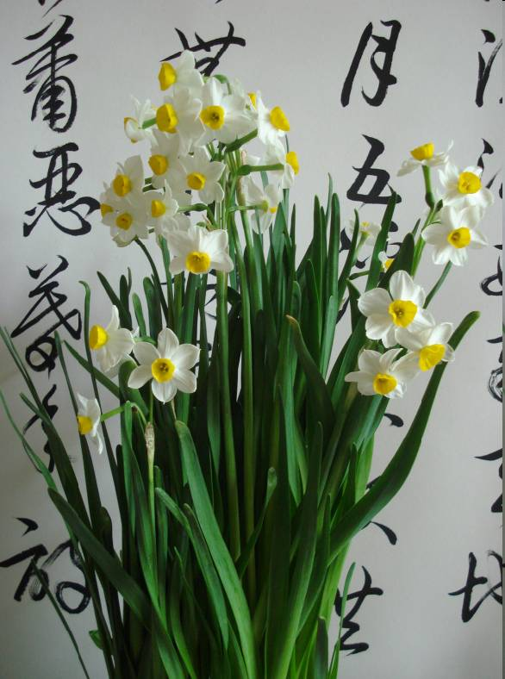
Chinese written symbols are called characters.

Slide 3
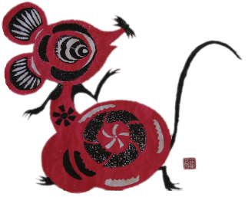
Chinese is written in three directions:
Vertical right to left (traditional)
Horizontal right to left (occasional)
Horizontal left to right (modern)
你爱我
小 我
老 爱
鼠 你 ,
我爱你
。

Slide 4
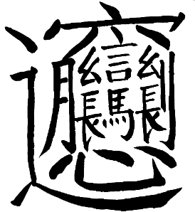
一
Chinese is written using stroke order, with a stroke defined as the single motion of a pen. The simplest character has just 1 stroke, while the most complex so far has 57! The average character has 9.8 strokes.

Slide 5
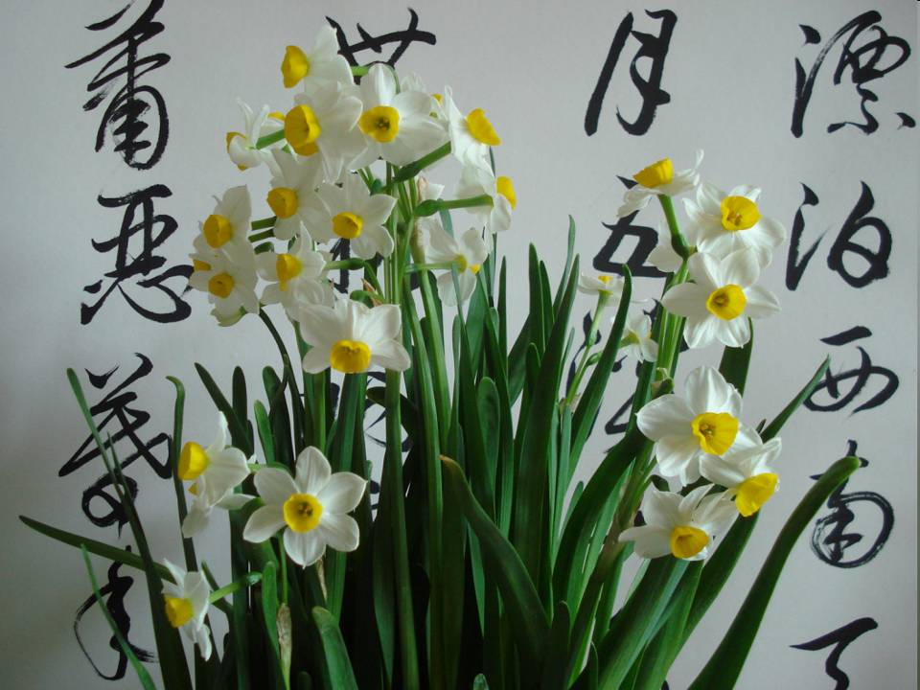
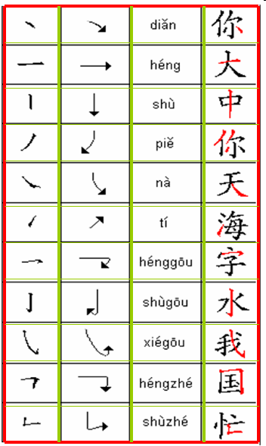
DO YOU KNOW THE NAMES OF THE STROKES BELOW?
Can you read or write them properly?
1.Dot
2.Horizontal
3.Vertical
4.Downward Left
5.Downward Right
6.Upward
7.Horizontal Hook
8.Vertical Hook
9.Slanted Hook
10.Horizontal Bend
11. Vertical Bend

Slide 6
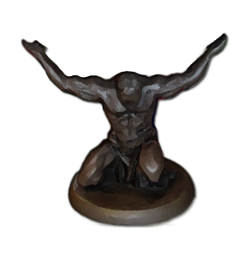
Although there are many dialects of Chinese the written language is the same throughout China and across the globe.

Slide 7
The contemporary Chinese characters do not resemble the original characters. This is a result of changes in writing materials and instruments.
Sun rì
Moon yuè
People rén

Slide 8
Although more than one system of Romanization exists for Chinese characters, Pinyin, the system adopted by China, is the most common. Pinyin uses all the letters in the English language except for “V”. In addition Pinyin uses “Ü” (umlaut U).
PIN=“Spell”
YIN=“Sound”

Slide 9
While Chinese uses traditional and simplified characters not all speakers can write both.
Traditional Chinese is used in Taiwan, Hong Kong and most places worldwide and simplified is used by the United Nations and in mainland China.
Definition | Traditional | Simplified | Pinyin
Traditional characters | 繁體字 | 繁体字 | fántǐzì
Simplified characters | 簡體字 | 简体字 | jiǎntǐzì

Slide 10
The first Chinese characters came about as attempts to record natural phenomena. Pictographic, Ideographic, Compound Ideographic and Pictophonetic are the four primary character types.
yún
CLOUD

Slide 11
River 河
Lake 湖
Ocean 海
In written Chinese there are over 200 radicals. Radicals help us understand the meaning of a Chinese character. For example, a water radical, 氵, which is indicated by droplets, suggests that the character is probably related to water. Yet the radical is not always easy to determine. Sometimes a whole character may be, itself, a single radical.

Slide 12
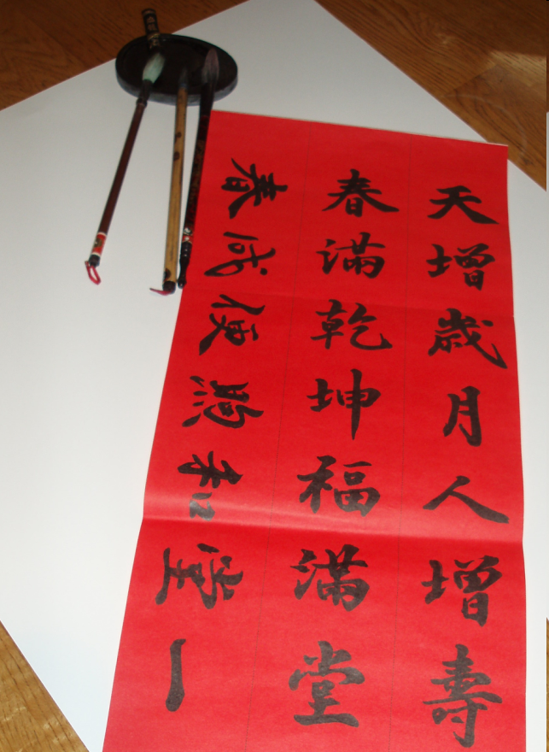
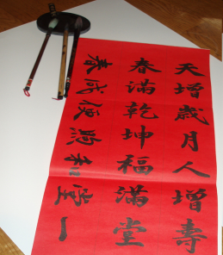
Writing Chinese characters with brush pens has developed into an art form known as calligraphy. There are four materials needed for the practice of calligraphy – brush, ink, ink stone, and paper. Regular style, cursive style, and freestyle calligraphy are the three main styles of Chinese calligraphy.

Slide 13
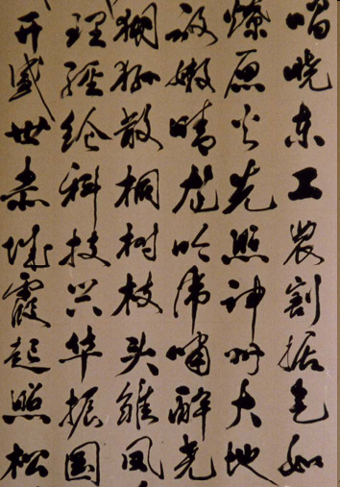
Chinese handwriting can be very difficult to read — entirely new characters are often used. Mastering this is a skill in itself.

Slide 14
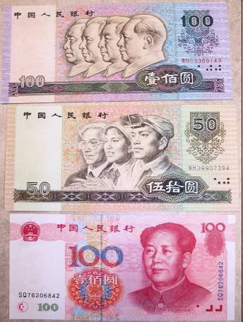
To prevent forgery Chinese money often incorporates highly complex characters.

Slide 15
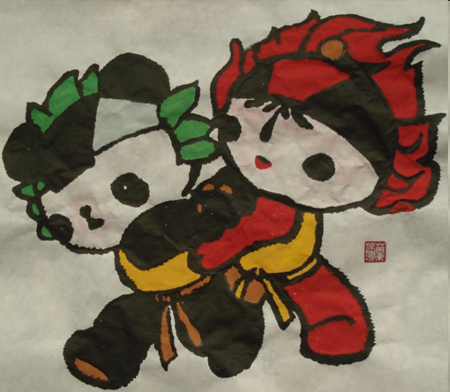
Most Chinese literature can be understood with a knowledge of roughly 2,500 characters — the level of comprehension expected of an elementary school graduate.
2
5
0
0

Slide 16
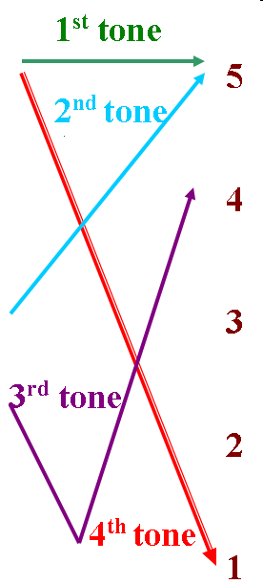
The vast majority of Chinese characters are monosyllabic. Romanization practices often use accent or tone marks to assist with pronunciation.

Slide 17
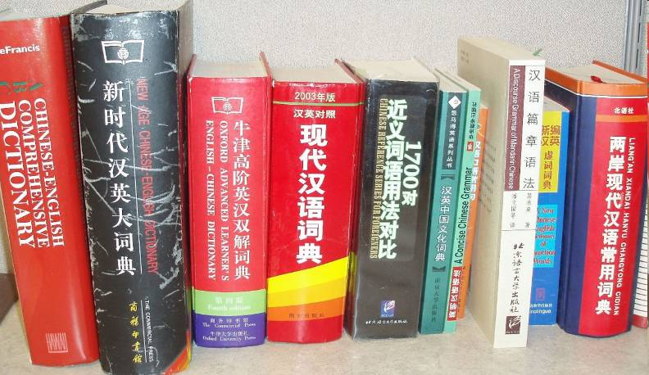
The length of a book is measured by the total number of characters rather than by the number of pages.

Slide 18
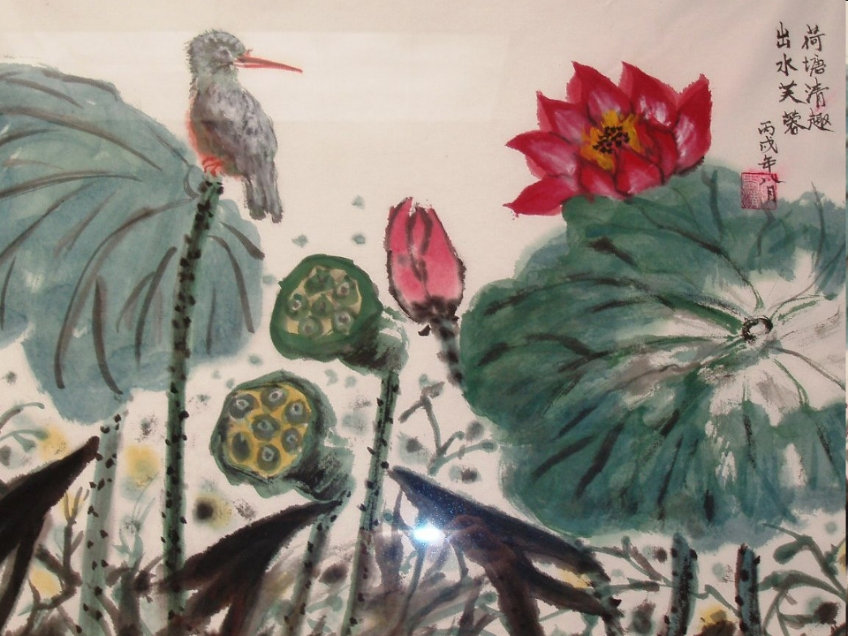
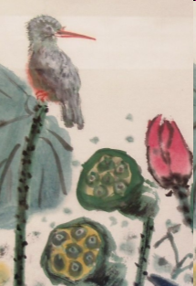
Although written Chinese makes use of familiar punctuation, such as question marks and colons, there is a special Chinese period, 。, which connects similar items, much like a comma. A single Chinese sentence can run the length of a whole paragraph.

Slide 19
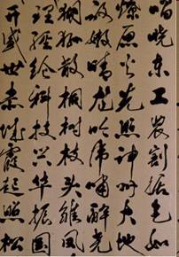
Both Korean and Japanese have incorporated Chinese characters into their written forms. The Japanese have created Chinese characters of their own that the Chinese themselves cannot read.
圓
円
Chinese Yuan Japanese Yen
Currency Comparison

Slide 20
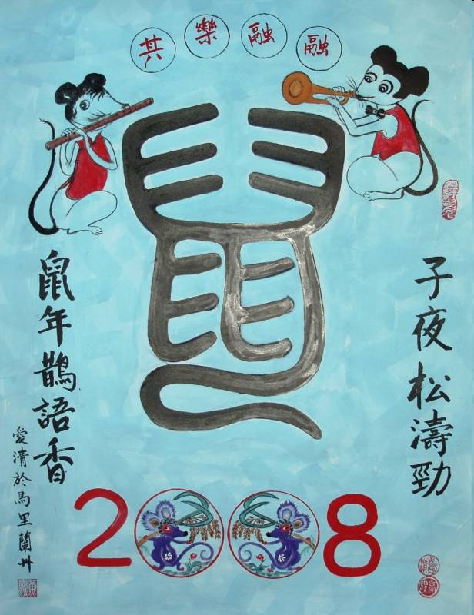
THANKS 감사 ありがとう
谢谢

