Slide 1
量
量=V. measure; size up
N. measure; capacity; amount
Measure

Slide 2
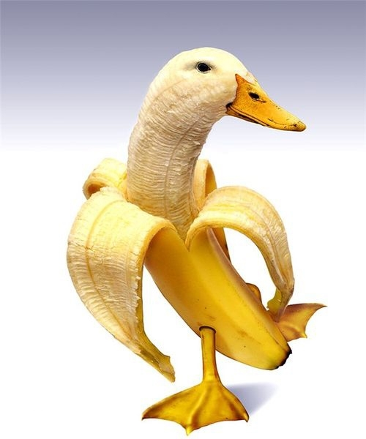
一根香蕉
One banana

Slide 3
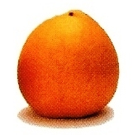
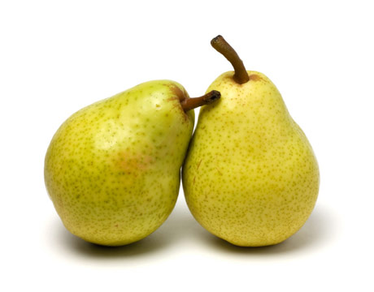
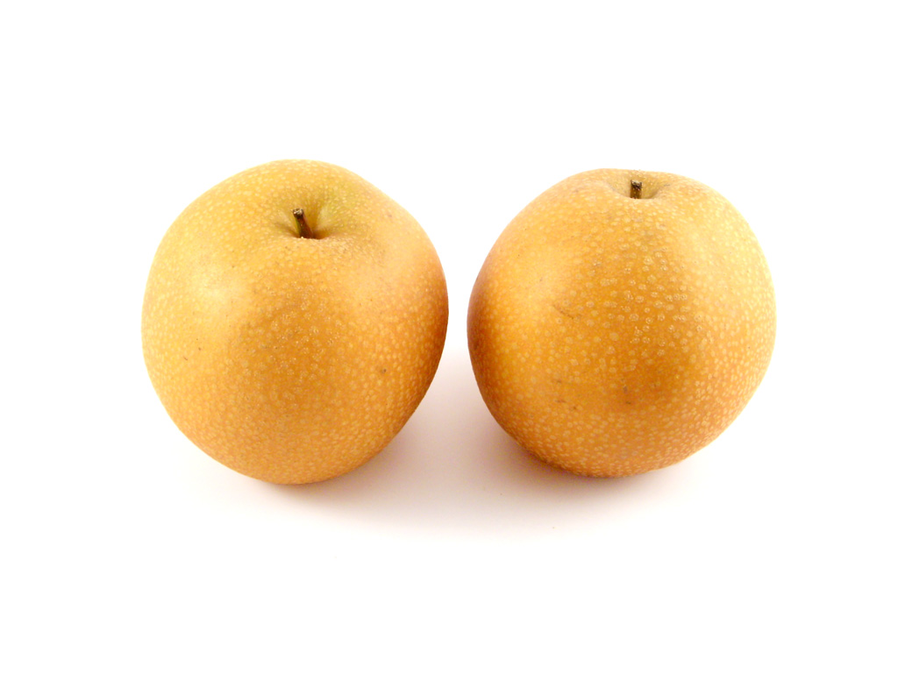
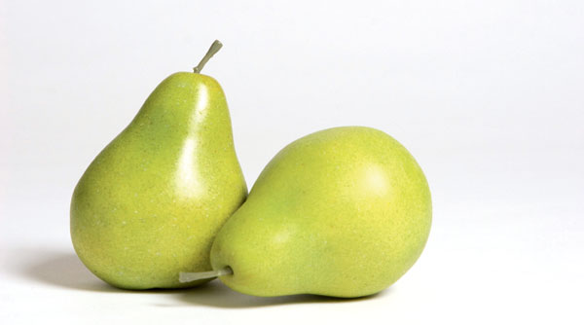
两个梨 兩個梨
Two pears

Slide 4
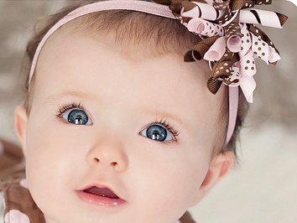
两只眼睛 兩隻眼睛
Two eyes

Slide 5
四只脚 四隻腳
Four feet

Slide 6
三支铅笔 三枝鉛筆
Three pencils

Slide 7
六本书 六本書
Six books

Slide 8
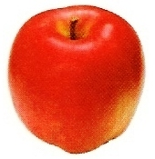
四个苹果 四個蘋果
Four apples

Slide 9
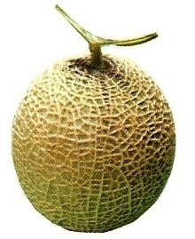
八个瓜 八個瓜
Eight melons

Slide 10
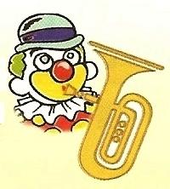
五个小丑吹喇叭 五個小丑吹喇叭
Five clowns blow the horns.

Slide 11
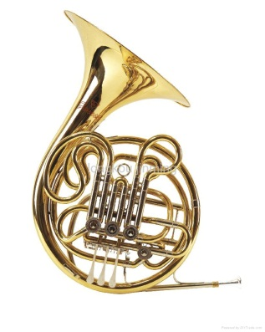
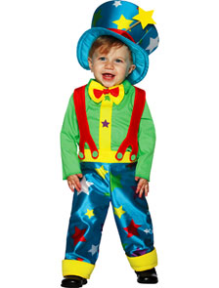
五个小丑吹喇叭 五個小丑吹喇叭
Five clowns blow the horns.

Slide 12
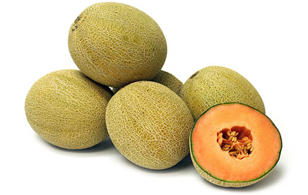
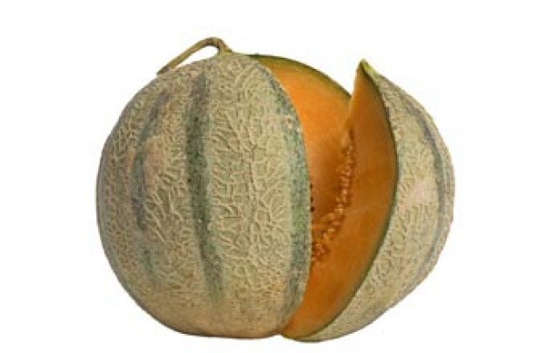
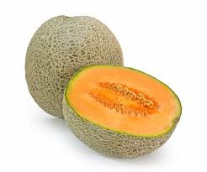
八个瓜 八個瓜
Eight melons

Slide 13
生氣的梨
生气的梨
Angry pear

Slide 14
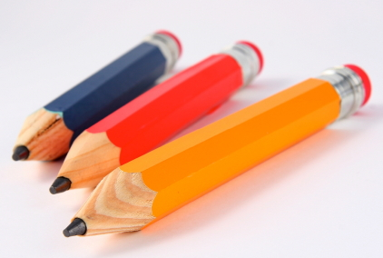
三支铅笔 三枝鉛筆
Three pencils

Slide 15
两个梨 兩個梨
Two pears

